Slide 1
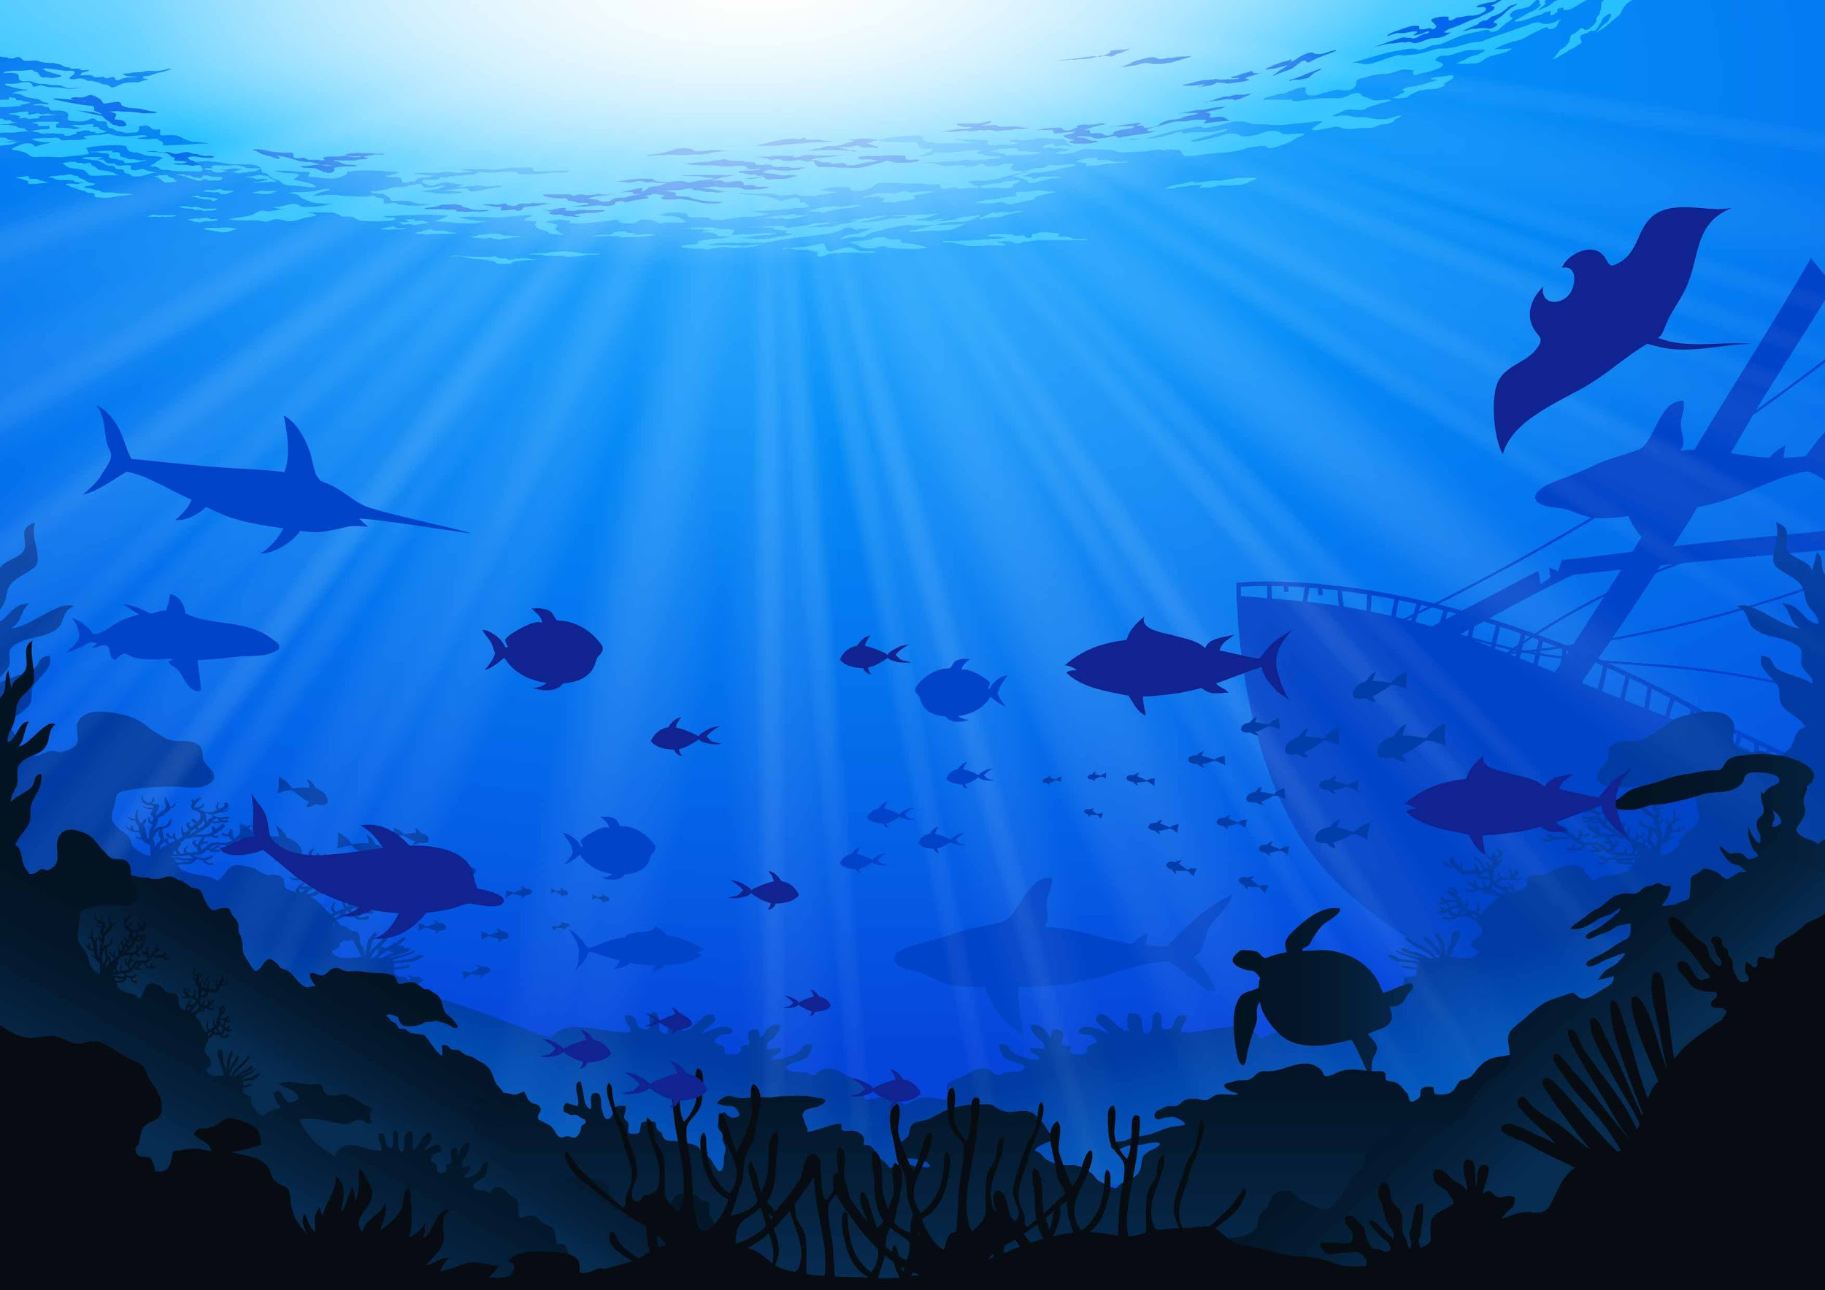
Team Greg
Edan Abiri, Aleksei Martynchik, Mason Bloomfield, Dennis van Ee

Slide 2
General Information
Underwater environment simulation
Ocean surface simulation
Schooling fish with predator/prey dynamics
Simulated kelp
Animated crustaceans
Physically based Volumetric lighting
Height field water simulation
Algorithms
Catmull-Rom splines
VE-springs
Quaternions
Particle Simulations
Morph Targets
Height field water simulation

Slide 3
Engine Overview
Deferred renderer
Position, normal, color, specular color
Metalness, roughness, baked ao
PBR lighting
Cook-Torrance BRDF
Image based diffuse lighting
HDR
Multiple passes
Shadow
Deferred Geometry
3 Lighting (ambient, directional, point)
Forward Geometry
Bloom
2 fog (depth, volumetric)
Tonemapping

Slide 4
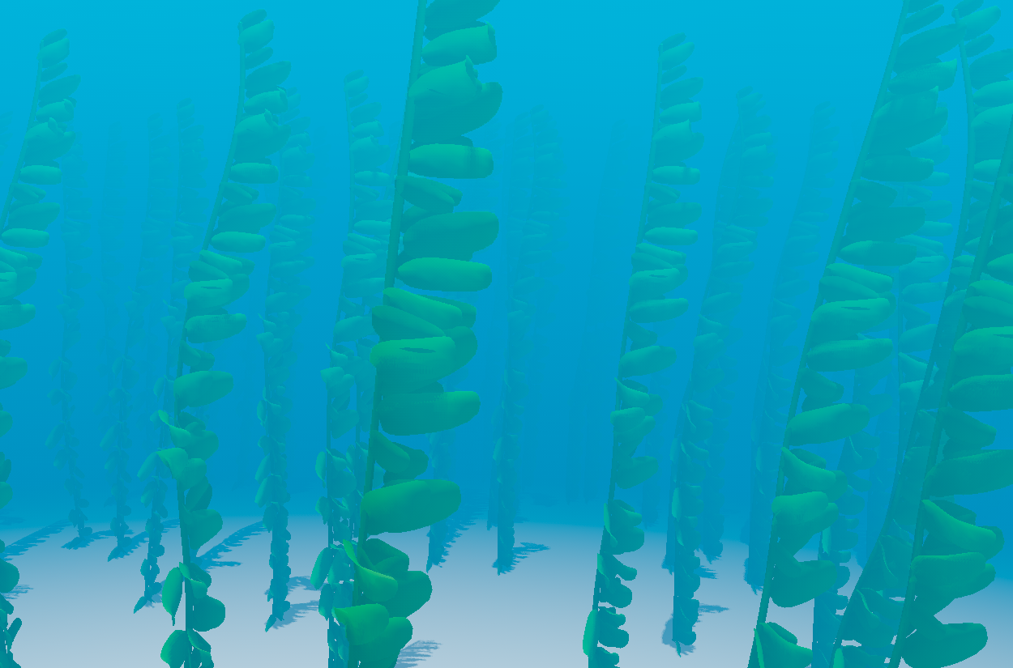
Kelp
2 Types
Type 1
Visco-elastic springs
Hermite Catmull-Rom splines
Fluid movement
Type 2
GPU instanced
Perlin-noise based animation

Slide 5

Schooling Fish
Fish Based on Boids algorithm
Attractive Force
Separation Force
Cohesion Force
Avoidance Force
Predators are single AI agents
Attracted to nearby density of small fish
Collision with kelp
Quaternions for orientation
All animation done in vertex shaders

Slide 6
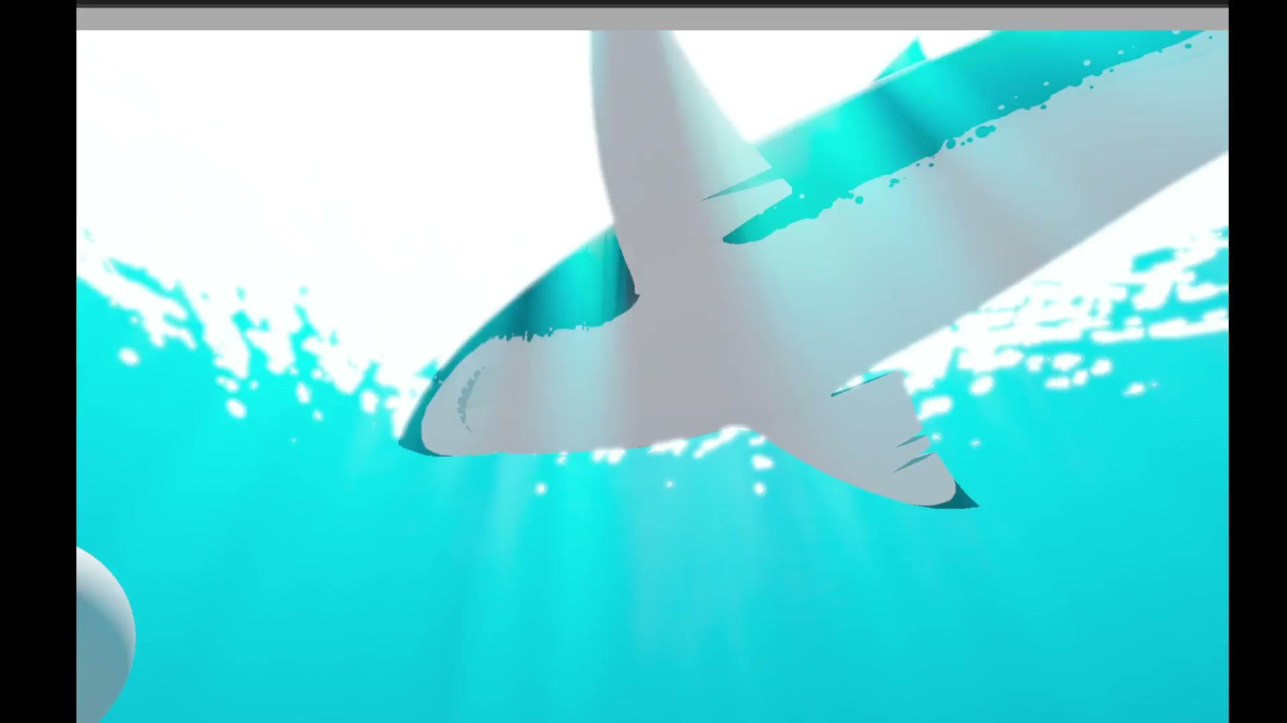
Volumetric Lighting
Based on implementation from Killzone Shadowfall (2014)
Algorithm outlined in GPU Pro-5
Ray march from camera to sampled point
Use mie scattering to find amount of light scattered towards camera
Sample camera depth buffer for shadow calculations
Scroll caustics texture over camera depth buffer to simulate light shafts

Slide 7
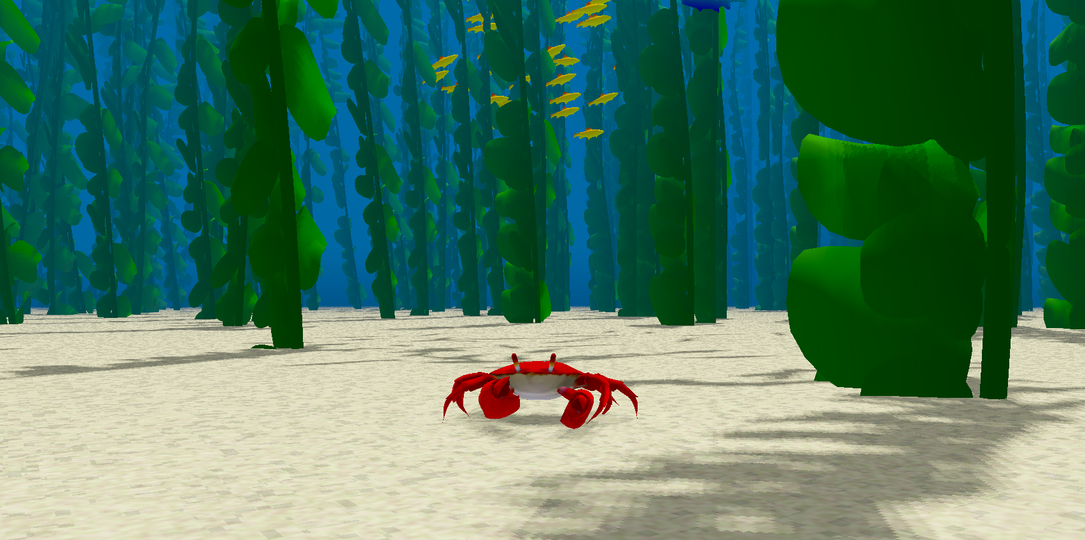
Crabs
Blender model
Randomized Spline Pathway
(Somewhat) Realistic crab movement
Waving Claws
Animated using blend-shapes/morph targets

Slide 8
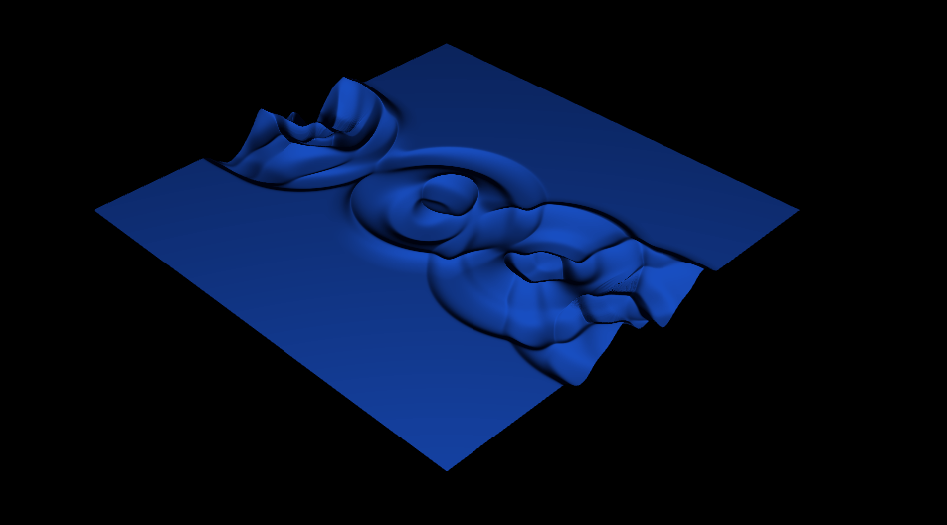
Height Field Water Simulation
Simulate the water ripple effects on the GPU (WebGL has no compute shader, so use fragment shader to perform compute).
Use RGBA texture to store state (R is column height, G is velocity, B and A are used for tangents).
Water surface shader uses state texture to in vertex shader to displace water.
Currently a simple phong-shader to demo water, more realistic water shader will come during finalization.

